Slide 1
PSYC 741 Hierarchical Linear Modeling
Session 3 – The Null Model and Estimation of
Multilevel Models

Slide 2
Overview of Today’s Class
Lecture and Discussion
The Null Model
Estimation of Multilevel Models
R tutorial
Introduction to lmer() in R
Estimating (Null) Multilevel Models
In-Class Assignment

Slide 3
The Null Model
Overview of the Null model
Example Formula and notation
Intraclass correlation coefficient
Likelihood ratio tests

Slide 4
Overview
What is the null model in multilevel modeling and what purposes does it serve?
A model with a random intercept included (for the group/cluster variable), but no other predictors
Two main purposes
Establish the degree of clustering of the DV (e.g., to see if MLM is necessary)
As a baseline model to compare subsequent models to based on fit to the data

Slide 5
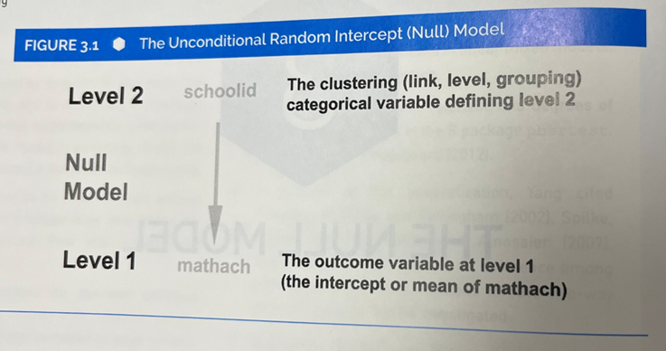
Example from Textbook

Slide 6
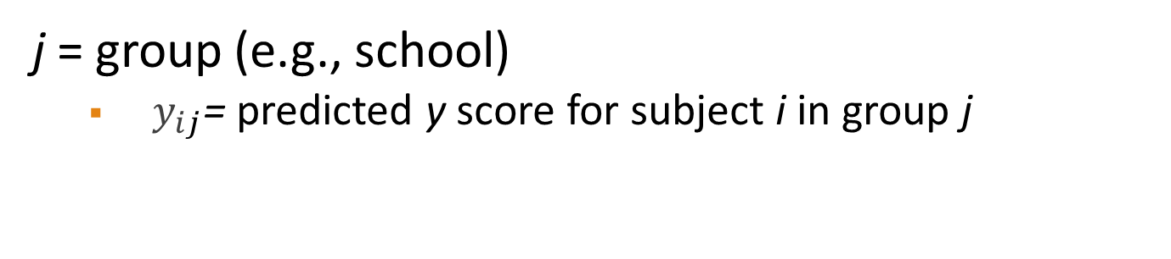

Example Formula
$$y_{ij}=β_{0_{j}}+e_{ij}$$
j = group (e.g., school)
$y_{ij}$= predicted y score for subject i in group j

Slide 7
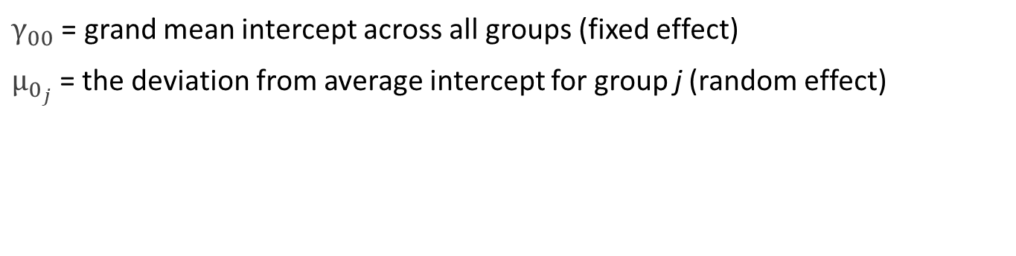
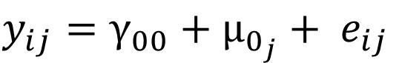
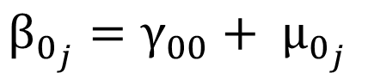
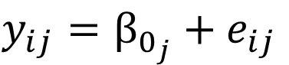
Random Intercept Included
$$y_{ij}=β_{0_{j}}+e_{ij}$$
$$β_{0_{j}}=γ_{00}+ μ_{0_{j}}$$
$$y_{ij}=γ_{00}+μ_{0_{j}}+ e_{ij}$$
$γ_{00}$ = grand mean intercept across all groups (fixed effect)
$μ_{0_{j}}$= the deviation from average intercept for group j (random effect)
Notes:
e_{ij} = within-group error
Once we add predictors, we are trying to see how much of the within-group error can be reduced OR how much of the within-group variance can be explained by those added predictors
Why are the random effect called random effect?
- Because the level-2 groups are a random draw of groups from population of groups

Slide 8
Intraclass Correlation Coefficient
The proportion of variance in the DV accounted for by the random intercept in the null multilevel model
Ranges from 0 to 1
Similar interpretation as R-square in linear regression and eta-squared in ANOVA
Higher values imply greater clustering of the DV based on the Level-2 grouping variable

Slide 9
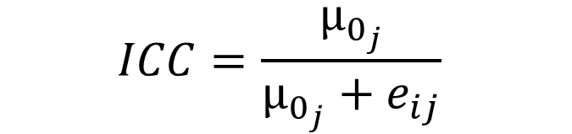
Intraclass Correlation Coefficient Formula in the Null Model
The variance from the random intercept divided by the total variance (i.e., the random intercept variance plus the residual Level-1 variance)
$$ICC=\frac{μ_{0_{j}}}{μ_{0_{j}}+e_{ij}}$$

Slide 10
Likelihood Ratio Tests (LRT)
The likelihood of ML is a measure of model error
-2 times the log-likelihood (-2LL) conforms to a chi-square distribution
-2LL sometimes called model “deviance”
No standardized or absolute cutoffs for -2LL, since these values are influenced by sample size and model complexity
But the deviance values of nested models can be compared to one another
Notes:
Log likelihood of 0 – 1 would always be negative → thus, we multiply by -2
Minimizing (error) is easier than maximizing (predictability) → which is why we use -2LL (deviance/error)

Slide 11
Cautions with LRTs
Models must be nested
Restricted ML (REML) not appropriate if using LRT to compare models with different fixed effects
ML appropriate if models differ in fixed effects
The effect of sample size
The impact of model misspecification (e.g., wrong covariance structure)
The impact of missing data on predictor variables
Notes:
MLM automatically does listwise deletion, thus, when adding a predictor (if it has missing values), the model will have a different sample size than the base model
If different sample sizes, the LRT doesn’t have any meaningful values because -2LL isn’t standardized and heavily depends on the sample size

Slide 12
Estimation of Multilevel Models
Fixed and random effects
Maximum likelihood vs. restricted maximum likelihood
Other estimation methods
Robust and Cluster-robust standard errors

Slide 13
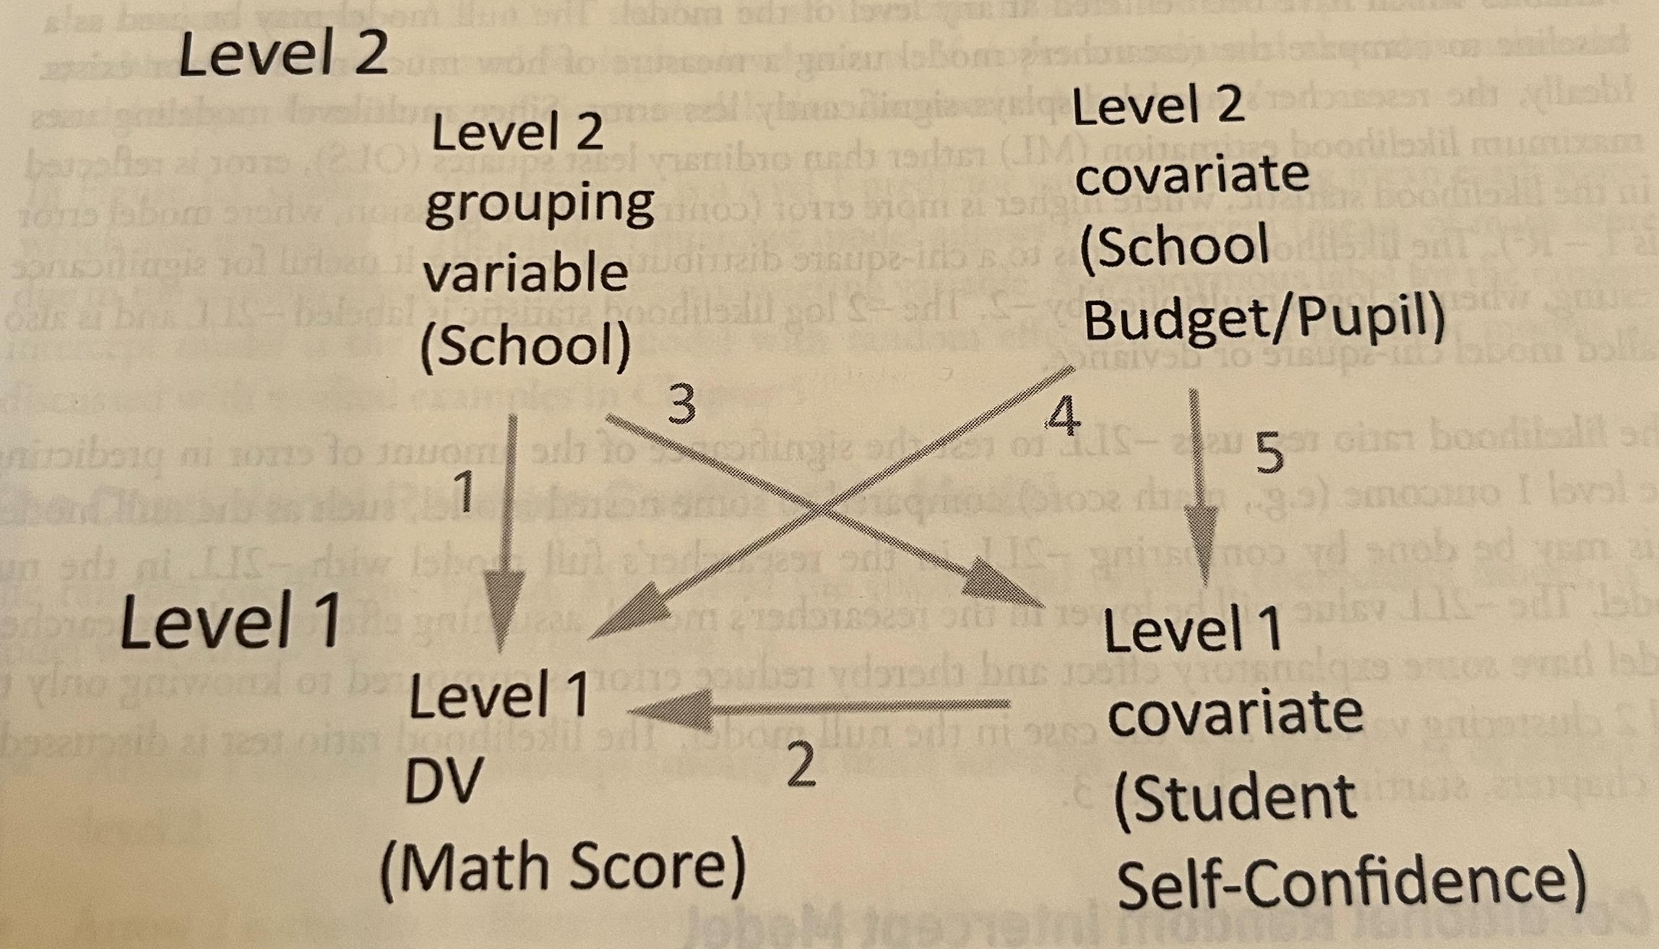
Fixed Effects
Similar to predictor variables in OLS regression
A unit increase in X is associated with a B change in the DV (adjusting for other predictors in the model)
DV is always at Level 1 but fixed effects can be either Level 1 or Level 2 (or higher in 3+ level MLMs)

Slide 14
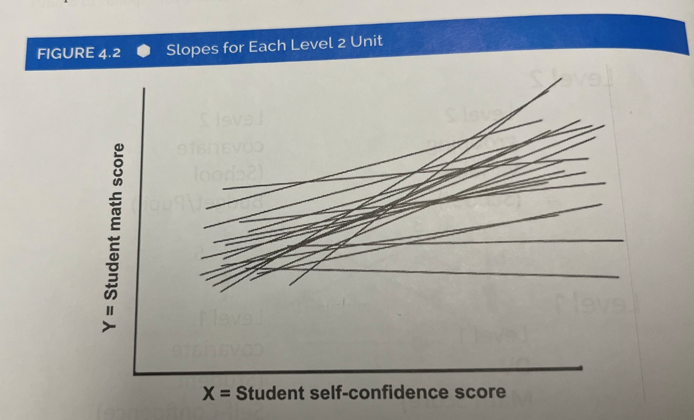
Random Effects
Variance in certain effects across the group/cluster variable
Intercept: the clustering of the DV based on the group/cluster
Slopes: the variance of a Level-1 predictor based on the group/cluster variable

Slide 15
Fixed and Random Effects (continued)
Other than the group/cluster variable, all predictor variables at any level of the model will be entered as fixed effects
Even if a random effect is also included in the model for that particular predictor (i.e., a random slope)
MLMs will generally include both fixed and random effects of some sorts, which is why they are also referred to as “mixed models” or “mixed-effects models”

Slide 16
Maximum Likelihood (ML) Estimation
An estimation method that finds parameter values which “maximize” the likelihood of predicting the DV
Often consistent and efficient estimates
Needed when comparing nested models with different fixed effects through LRTs
Not recommended when:
Samples size is very small (Level 2)
The DV has “severe” non-normality (less of a concern with very large samples)
Various bootstrapping methods recommended in these situations
Notes:
Estimation (ML, REML) -> Different ways to estimate the best parameters (beta coefficient [fixed, random])

Slide 17
Restricted Maximum Likelihood (REML) Estimation
Only uses the random effect(s) to estimate the likelihood function (hence the “restricted”)
The fixed effects are estimated in a separate step
In some situations, will give less biased estimates than ML:
Less influenced by outliers
Better deals with high correlations in the model
Handles smaller sample sizes “better” (especially smaller Level-2 sample sizes)
Not recommended or appropriate when:
Comparing nested models
Comparing nested models with different parameterizations
Comparing nested models with different fixed effects
Notes:
If you are not sure → run multiple analyses (ML, REML, Bootstrap)

Slide 18
Other Estimation Methods in MLM
Bayesian Estimation
Monte Carlo Markov Chain (MCMC)
Generalized Least Squares (GLS)
Bootstrap methods
Non-normal data
Smaller sample size
Asymptotically distribution free (ADF)
Weighted Least Squares (WLS)

Slide 19
Robust and Cluster-Robust Standard Errors
Robust SEs adjust estimates for violations of assumptions (e.g., non-normality, outliers, heteroskedasticity)
Often the default in MLM software programs (e.g., Huber-White SEs)
Cluster-Robust SEs can sometimes:
(1) be a synonym for Robust SEs when the standard errors are clustered by the grouping variable in the MLM
(2) when you wish to cluster SE estimates by a categorical variable other than the grouping variable in the MLM
Notes:
Fine to use these two methods if you are only concerned about the non-independence

Slide 20
Next Class
Lecture Topics:
Random Intercept Models
R
Two-level Random Intercept Models in R
Readings that will be discussed
Textbook Chapters 5 and 6
Contributing to your participation grade, make sure to respond to the Readings Feedback/Questions submission on Canvas

